Slide 1
2. Robot Dynamics
2.1 Newton-Euler Formulations
2.2 Lagrange-Euler Formulation
2.3 Properties of Dynamic Models
2.4 Dynamics Tutorials
2.5 Neural Network Modelling
- 0 -

Slide 2
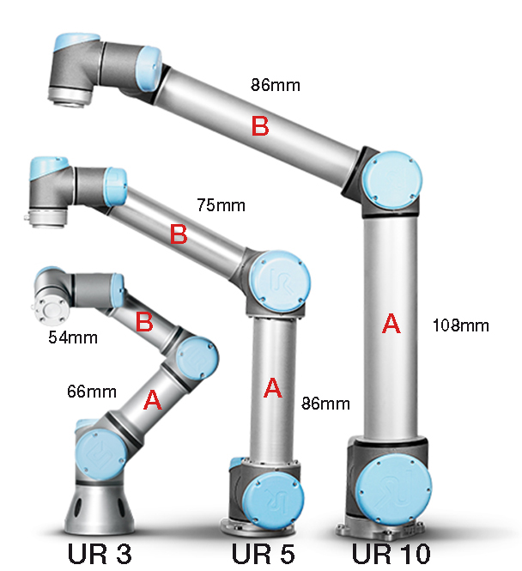
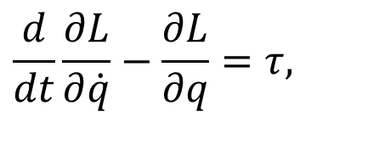
2.2 Lagrangian Method
2.2.1 The Preliminaries
Robot Dynamics based on Lagrange-Euler Formulation
Basic idea:
Apply the Lagrange-Euler Formulation to robots
$$\frac{d}{dt}\frac{∂L}{∂\dot{q}}−\frac{∂L}{∂q}=τ,$$
(Without considering frictions)

Slide 3
2.2 Lagrangian Method
The so-called Lagrange-Euler equation
where (Lagrangian Function)
with K and P being the kinetic energy and potential energy, respectively, and
= i-th generalized coordinate of robots
= i-th generalized force/torque of robots

Slide 4
2.2 Lagrangian Method
2.2.2 Generalized Coordinates
What are the generalized coordinates & forces / torques of robots?
A set of coordinates completely describe the location
( position and orientation ) of a robot with respect to
(w. r. t.) a reference frame.

Slide 5
2.2 Lagrangian Method
* Various sets of generalized coordinates exist.
* A common and natural choice of generalized coordinates is to use joint variables,
* In what follows, the variable quantity, i.e. θ_{i} for revolute joint and d_{i} for prismatic joint will be denoted by q_{i}.
for revolute joint
for prismatic joint

Slide 6
2.2 Lagrangian Method
2.2.3 Generalized Forces
The definition of generalized forces depends on the choice of generalized coordinates:
IF joint variables are chosen as the generalized coordinates, THEN the generalized force (or torque):
is the applied force or torque at joint i.

Slide 7
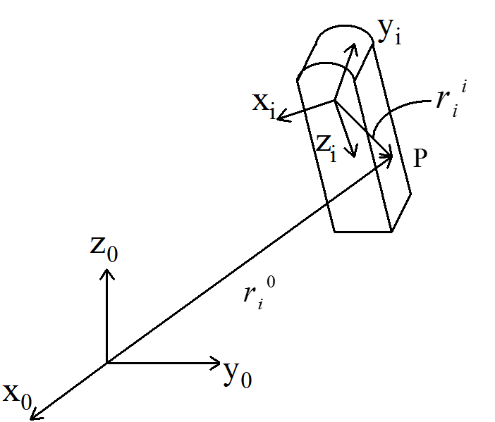
2.2 Lagrangian Method
2.2.4 Joint Velocity
With respect to (w.r.t.) the figure below, a point P fixed in link i can be expressed as
--------- w.r.t. frame i
--------- w.r.t. frame 0

Slide 8
2.2 Lagrangian Method
where with
homogeneous transformation matrix frame i expressed in frame i-1
Velocity:
How?

Slide 9
2.2 Lagrangian Method
Note that
( = 0 )

Slide 10
2.2 Lagrangian Method
Remarks:
1) General form of (Fu, et al P.87)
Revolute Joint
Prismatic Joint

Slide 11
2.2 Lagrangian Method
2) Definition of
Double Check?
Revolute Joint
Prismatic Joint
3) Velocity of

Slide 12
2.2 Lagrangian Method
2.2.5 Kinetic Energy (joint velocities)
Let be the Kinetic energy of link i w.r.t. the base.
(1)
(2)

Slide 13
2.2 Lagrangian Method
Note that , , and , are independent of the position in the link.

Slide 14
2.2 Lagrangian Method
Integrate over all the points

Slide 15
2.2 Lagrangian Method
2.2.6 Total Kinetic Energy

Slide 16
2.2 Lagrangian Method
where

Slide 17
2.2 Lagrangian Method
with
---- the mass of link
---- the centre of mass
---- the volume of link

Slide 18
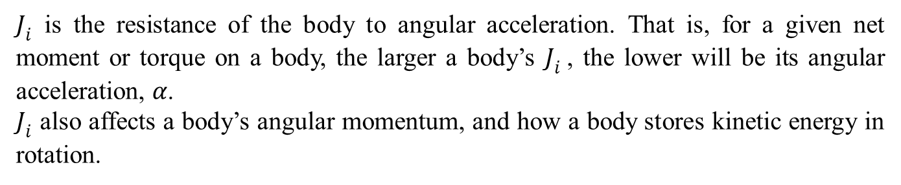
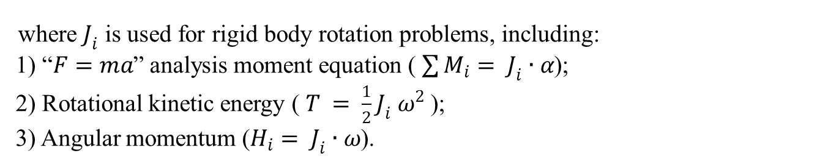

2.2 Lagrangian Method
The moment of inertia, also known as mass moment of inertia,
can be denoted with or and defined as follows.
(Units: $kg$/$m^{2}$ or $slug$/${ft}^{2}$)
where $J_{i}$ is used for rigid body rotation problems, including:
1) “$F=ma$” analysis moment equation ( $\sum{M_{i}}= J_{i}∙α$);
2) Rotational kinetic energy ( $T = \frac{1}{2}J_{i} ω^{2}$);
3) Angular momentum ($H_{i}$ $= J_{i}∙ω$).
$J_{i}$ is the resistance of the body to angular acceleration. That is, for a given net moment or torque on a body, the larger a body’s $J_{i}$, the lower will be its angular acceleration, $α$.
$J_{i}$ also affects a body’s angular momentum, and how a body stores kinetic energy in rotation.

Slide 19
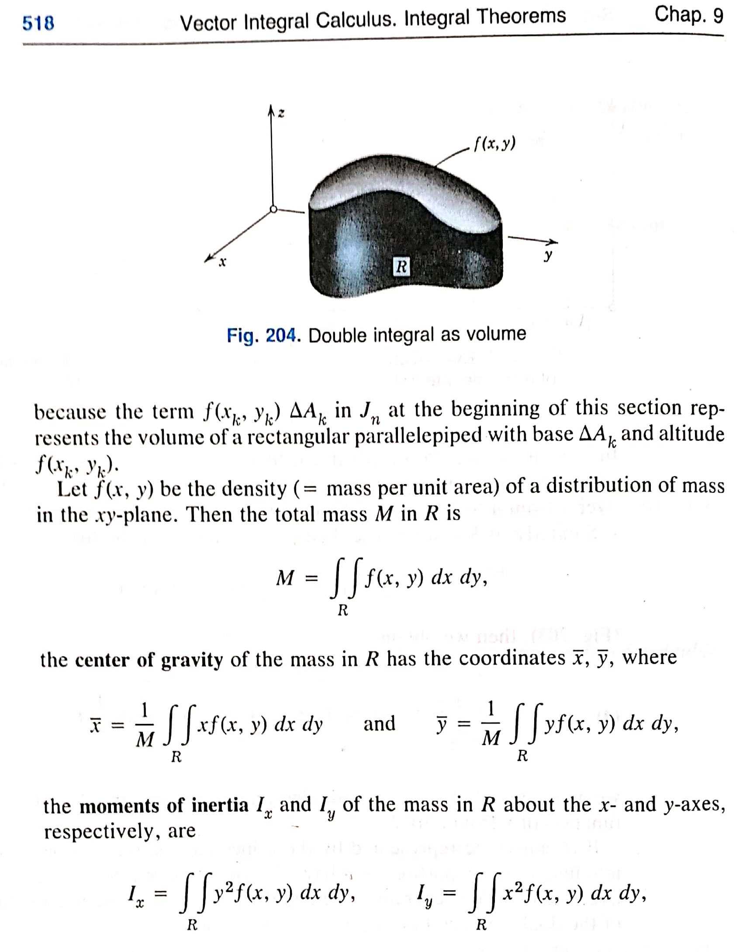
2.2 Lagrangian Method
Reference:
Advanced Engineering Mathematics,
Erwin Kreyszig and Wiley,
London, 1972:
Page 518

Slide 20
2.2 Lagrangian Method
Kinetic Energy can be expressed as
where
D is symmetric,

Slide 21
2.2 Lagrangian Method
Proof: Define

Slide 22
2.2 Lagrangian Method

Slide 23
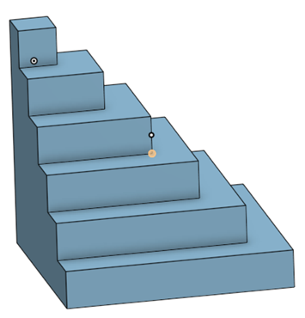
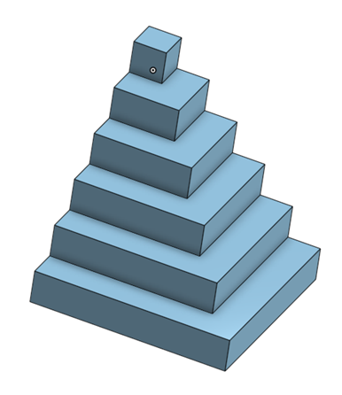
2.2 Lagrangian Method
The "pyramid" model of the Inertia matrix D(q)

Slide 24
2.2 Lagrangian Method
Potential Energy
For link i,
Total Potential Energy
: position of the mass centre
: mass of link i
g : gravity vector,

Slide 25
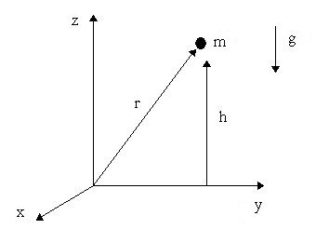
2.2 Lagrangian Method
Note that
For a level system

Slide 26
2.2 Lagrangian Method
2.2.7 Motion Equation
Lagrangian Function：
Lagrange-Euler equations：

Slide 27
2.2 Lagrangian Method
Therefore,

Slide 28
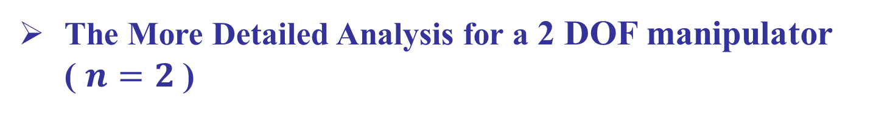
2.2 Lagrangian Method
The More Detailed Analysis for a 2 DOF manipulator ( $n=2$)

Slide 29
2.2 Lagrangian Method
By applying with the Lagrange-Euler equation:
Let
Then, the motion equations become
k = 1, ..., n
*

Slide 30
2.2 Lagrangian Method
Note that
Exchange the order of summation for 2nd term
*
Christoffel Symbols

Slide 31
2.2 Lagrangian Method
It is common to write the motion equations in matrix form as
joint variable vector
a vector of coriolis and centrifugal forces
a vector of gravity forces

Slide 32
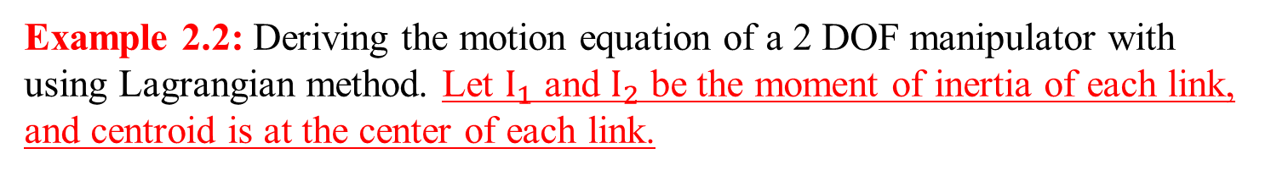
2.2 Lagrangian Method
Example 2.2: Deriving the motion equation of a 2 DOF manipulator with using Lagrangian method. Let $I_{1}$ and $I_{2}$ be the moment of inertia of each link, and centroid is at the center of each link.
By doing the derivation for the equation of centroid position of link 2, we can obtain the velocity of link 2:
Let
l_{2,} I₂
θ₂
D
y₁
m₂
B
x₁
l_{1,} I₁
y₀
z₁
C
θ₁
A
m₁
x₀
z₀
- 31 -

Slide 33
2.2 Lagrangian Method
Then we shall obtain the resultant velocity of link 2.
Equation (1)
Considering the Kinetic Energy of the system consists of the Kinetic Energy of link 1 and link 2 respectively, we can obtain that
See König's theorem (kinetics)
Equation (2)
- 32 -

Slide 34
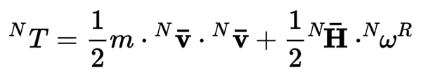



2.2 Lagrangian Method
König's theorem (Kinetics)
Kinetic energy of a system of particles is the sum of the kinetic energy associated to the movement of the center of mass and the kinetic energy associated to the movement of the particles relative to the center of mass.
where m is the mass of the rigid body; is the velocity of the center of mass of the rigid body, as viewed by an observer fixed in an inertial frame N; is the angular momentum of the rigid body about the center of mass, also taken in the inertial frame N; and is the angular velocity of the rigid body R relative to the inertial frame N
Reference:
Rao A. Dynamics of particles and rigid bodies: a systematic approach[M]. Cambridge University Press, 2006.

Slide 35
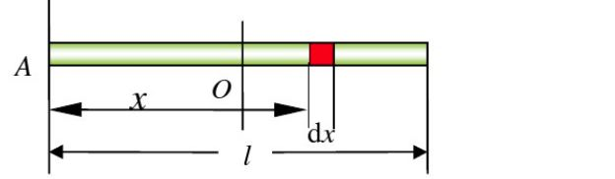
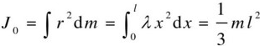
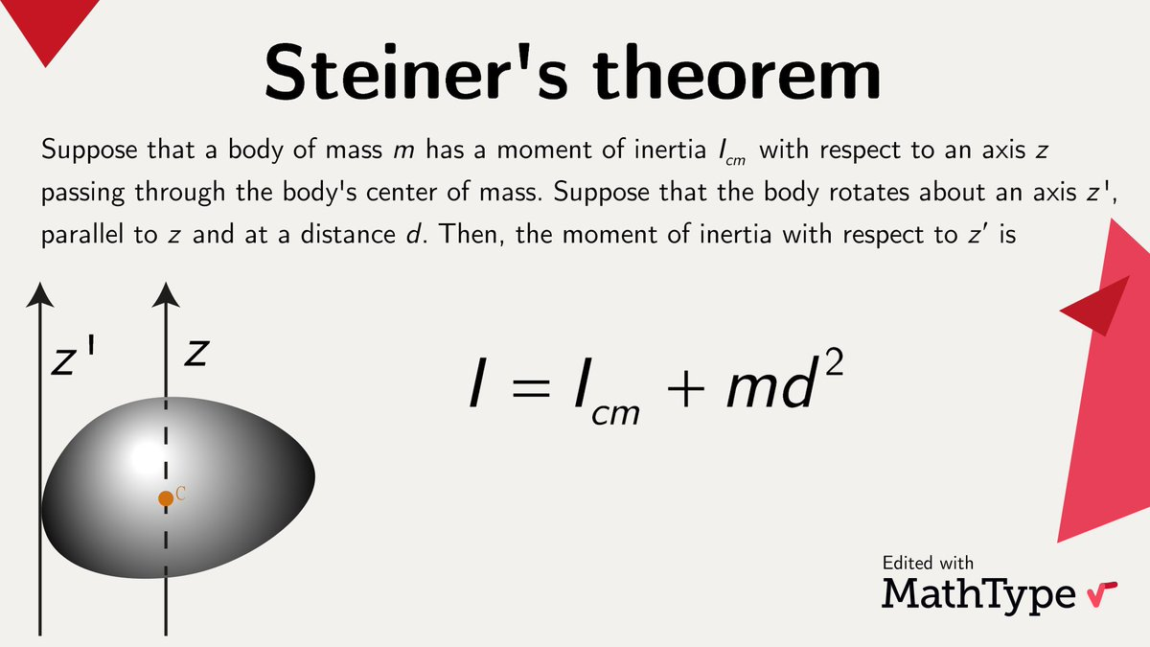
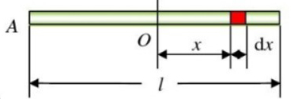
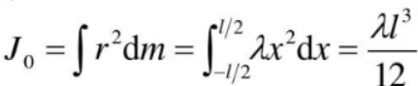



2.2 Lagrangian Method
Note
About the derivation:
The $λ$ denotes Mass linear density.
The rod is rotating along the axis at Point $A$.
The rod is rotating along the axis at Point $O$.
- 34 -

Slide 36
2.2 Lagrangian Method
After substituting Equation (1) into Equation (2), we can obtain that
Due to the Potential Energy of the system consists of the Potential Energy of link 1 and link 2, respectively, we can obtain that
- 35 -

Slide 37
2.2 Lagrangian Method
Based on the above derivation, we shall obtain the Lagrangian Function of the 2-DOF manipulator:
By conducting the derivative process for the above Lagrangian Function, we shall obtain the following two motion functions.
- 36 -

Slide 38
2.2 Lagrangian Method
Example 2.3: Derive the dynamic model for the mass system.
Newton-Euler Equation
Lagrange-Euler Equation
Kinetic energy:
Potential energy:
The Lagrangian:
Eq. of motion:

Slide 39
2.2 Lagrangian Method
Example 2.4: Derive the dynamic model for the Mass & Spring System.
Lagrange-Euler Equation
The kinetic energy:
The potential energy:
The Lagrangian:

Slide 40
2.2 Lagrangian Method
Example 2.4: Derive the dynamic model for the Mass & Spring System.
Lagrange-Euler Equation
where $τ = {\left[τ_{1} τ_{2}\right]}^{T}$ is an external applied force.

Slide 41
2.2 Lagrangian Method
Example 2.4: Derive the dynamic model for the Mass & Spring System.
Lagrange-Euler Equation
The work done by external force
Since , we have

Slide 42
2.2 Lagrangian Method
Example 2.4: Derive the dynamic model for the Mass & Spring System.
Lagrange-Euler Equation
From ,
we have the dynamics:

Slide 43
2.2 Lagrangian Method
Example 2.4: Derive the dynamic model for the Mass & Spring System.
Lagrange-Euler Equation
State space description:
Let

Slide 44
2.2 Lagrangian Method
Example 2.4: Derive the dynamic model for the Mass & Spring System.
(b) Newton-Euler Equation
From the figure, the equations of motion using Euler Equation is obtained as:

Slide 45
2.1 L-E and N-E Equations
Example 2.2: Derive the dynamic model for the Mass & Spring System.
Lagrange-Euler Equation
Newton-Euler Equation
By moving the terms associated with displacements to the left hand sides of the equations, it can be seen that we have the same set of equations for the same system using different modelling methods.

Slide 46
2.2 Lagrangian Method
How many ways to obtain the dynamics of robots?
How to obtain the dynamic model for 1, 2, and n-DOFs manipulator?
Are there any other ways to obtain robot dynamics?

